Slide 1
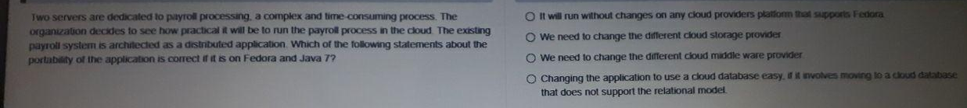
Ans : It will run without changes on any cloud providers platform that supports Fedora.

Slide 2
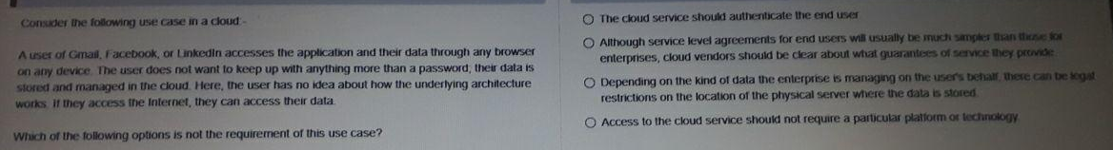
Ans: The cloud service should authenticate the end user

Slide 3
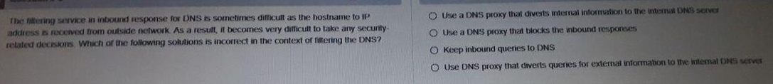
Ans: Keep inbound queries to DNS.

Slide 4
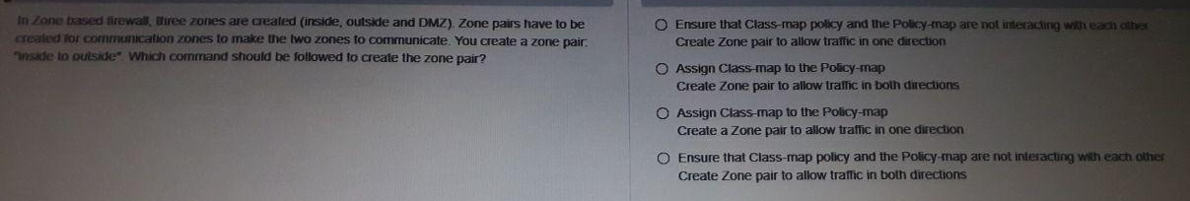
Ans :
Assign Class-map to the Policy map.
Create a Zone pair to allow traffic in one direction.

Slide 5
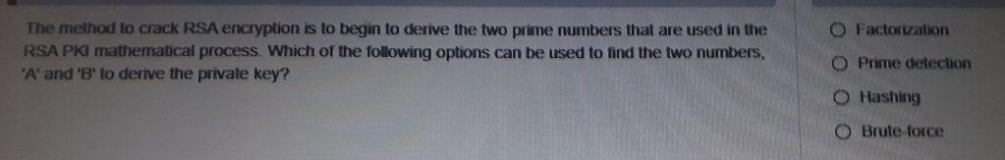
Ans : Factorization

